Slide 1
Meal Kit E-Commerce Application
Techsperts
Eissa Purnell, Jayson McShan, Kendall Bliss
Notes:
Jayson

Slide 2
Pitch
People who lead busy lives often struggle to find the time to plan, shop for, and prepare healthy and delicious meals. Recognizing the gap between a tight schedule and the desire for nutritious eating, our platform offers a solution. Users can easily browse and choose from a variety of curated meal kits tailored to diverse tastes and dietary preferences. With our e-commerce site, not only do they receive all the pre-portioned ingredients directly at their door, but they also get step-by-step instructions to whip up a delightful dish in no time. This ensures that even amidst a hectic day, anyone can enjoy a fresh, home-cooked meal without the usual hassles. Embrace convenience, variety, and health with our innovative Meal Kit platform.
Notes:
Eissa

Slide 3
Concept
Description
Motivation for Development
Meal Kit E-Commerce site offers the user the ability to browse all meal kits or filter them by there protein (pork, beef, seafood and even vegetarian) as well as by the style (Mexican, Asian, Continental etc.) Users can also look at an items details and see the price and ingredients and place an order and see their order history.
Inspired by the dynamic landscape of e-commerce and the ever-evolving needs of modern consumers, we aspired to craft a platform that not only challenges our development capabilities but also enriches our understanding of user-centric design. This venture has been both a learning curve and a stepping-stone, equipping us with invaluable insights that we believe will steer us to even greater heights in future product developments."
Notes:
Kendall

Slide 4
Concept Cont.
User Story
Acceptance Criteria
AS A developer who owns a meal-kit company
I WANT an e-commerce website
SO THAT I can sell my meal-kits online
When a user visits a site
Then they are given an option to login or create an account
When the user logs in
Then they are presented with a home page where they can select a meal kit category
When a user selects a meal kit category
Then they are presented with a list of meal kits that match the criteria
When they are presented with a list of meal kits
Then they can select a meal-kit to get more details on a dedicated product page
When viewing the product details
Then they can select an option to order the product
When they select the option to order the product
Then they are taken to a dedicated order page with the product details present
When they view the product order page,
Then they are presented with a name and address field as well as a quantity of the order and payment method
When they submit the order
Then the order is stored in a backend database with quantity and payment
Notes:
Jayson

Slide 5
Process
Technologies Used
Breakdown of Tasks and roles
Main Framework
HTML, CSS, JavaScript
Third Party API’s
Tailwinds Node Module for CSS
Node Modules
Bcrypt
Connect-session-sequelize
Dotenv
Eslint
Eslint-config-prettier
Express
Express-handlebars
Express-session
Mysql2
Prettier
Sequelize
tailwindscss
Other
MS Visio – Wireframe
insomnia
Live Share VS Code Extension
We utilized the live share VS Code Extension to work on our code simultaneously during work sessions, so most of the tasks were completed as a group.
Product Seeding, user seeding, and product research done by Eissa Purnell
Handlebars, Heroku Deployment and server.js configuration was done by Jayson Mcshan
Routes and client side Javascript files were done by Kendall Bliss
Notes:
Eissa

Slide 6
Process cont.
Successes
Challenges
Teamwork, able to work effectively as a team with no major issues with merging or pull request
Able to create robust seed file to provide site with some excellent content right out of the gate
Worked as a team to develop a lot of the handlebars and routes functionality
Able to deploy the Tailwinds Node module which is really effective at styling our website
Figuring out how to seed our website after it was deployed on Heroku so our products and categories would show
Login/logout/sign up routes gave us a lot of trouble
Getting our HTML elements to provide the proper payloads for routes to work
Setting up our data table relationships was a challenge in the beginning
Notes:
Kendall

Slide 7
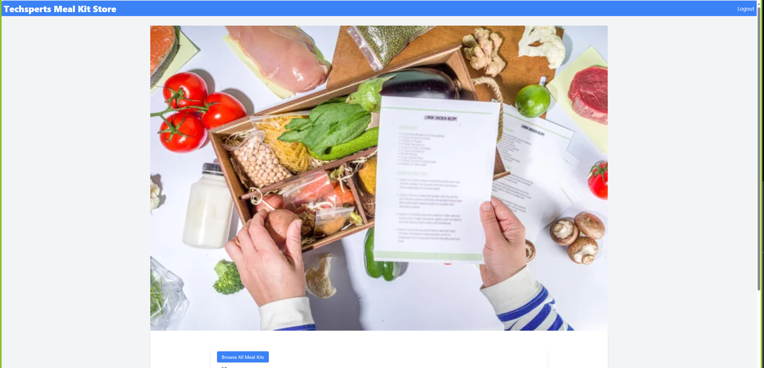
https://techspert-meal-kit-store-7b3c1ba1d6db.herokuapp.com/login
Notes:
Jayson
https://immense-scrubland-93718-5f5721d95801.herokuapp.com/

Slide 8
Directions for future development
Add in additional API Routes for editing User Profiles
Add in an administrative portion of the site to allow for administrators to create new Styles/Proteins and products without having to seed them and redeploy
Add in more robust User Profiles in the user tables and add in more fields for tracking demographics (Email, Age, Sex, Address, Etc)
Add in a payment system to the back end like Pay Pal or some other form of “Credit Card” payment processing
Add in email notifications for Order/Payment Confirmation and order tracking
Ability to order multiple products at once (shopping cart)
Notes:
Kendall

Slide 9
Links to Content Any Questions?
GitHub Repository
https://github.com/jmcshan1/Meal-Kit-Store
Deployed Page
https://techspert-meal-kit-store-7b3c1ba1d6db.herokuapp.com/login
Other Resources
Tailwinds
Installation - Tailwind CSS
Notes:
Eissa

